Slide 1
HL3 MIR optical desigan
Xinhang Xu
2026/8/12

Slide 2
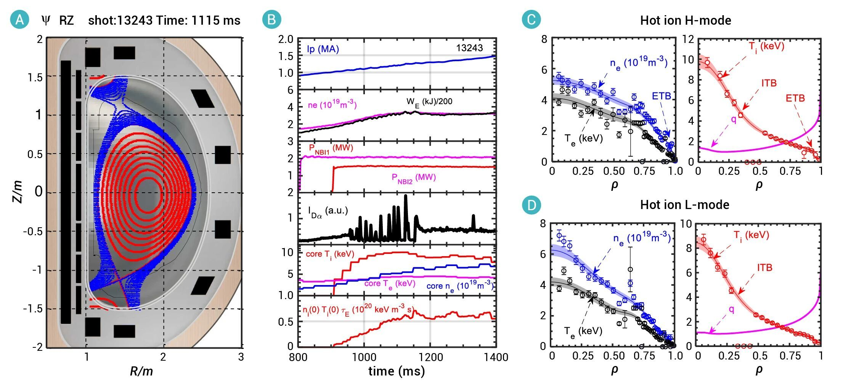
https://cloud.tencent.com/developer/news/3302737
From window to cutoff surface :0.8-1.2 m range

Slide 3
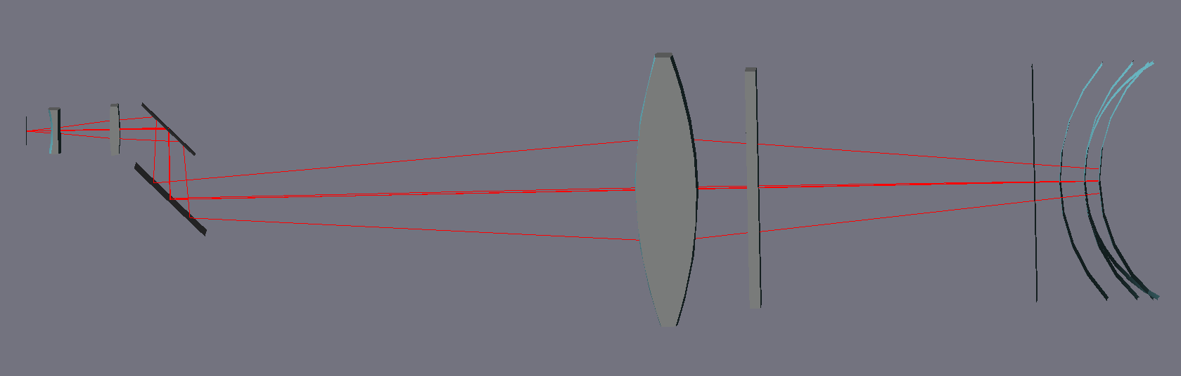
1st lens
window
mirror
s1
s2
Cutoff layer
horn
Gain lens
Zoom
beamsplitter

Slide 4
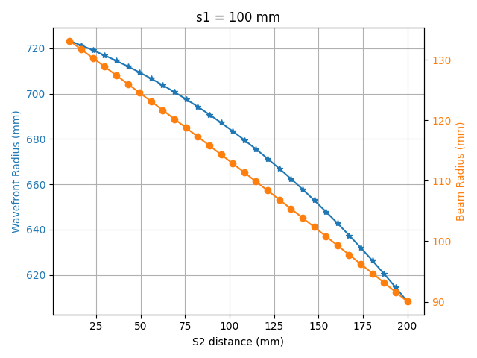
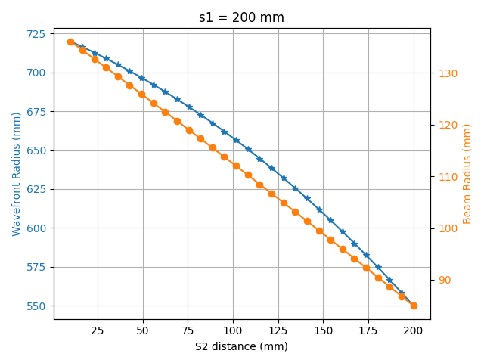
(a)
(b)

